Slide 1
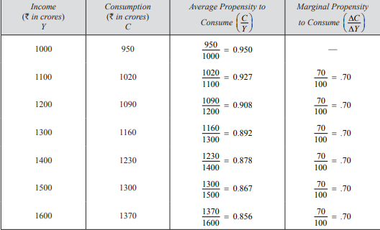
Consumption Function “C”
The consumption function relates the amount of consumption to the level of income.
The consumption function is the whole schedule which describes the amounts of consumption at various levels of income.

Slide 2
Continue…
Keynesian consumption function considers consumption as a function of current income
C = f (Y)
In a specific form, Keynesian linear consumption function can be written as:
C = a + bYd
where a and b are constants.
While a is intercept term of the consumption function, b stands for slope of the consumption function and therefore represents marginal propensity to consume and Y represents the level of current income.

Slide 3
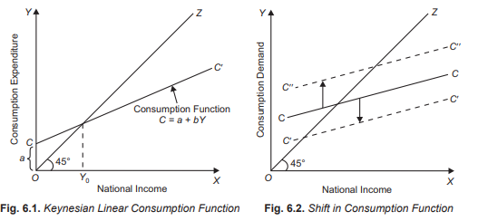
Continue…

Slide 4
Continue…
Marginal Propensity to Consume. The concept of marginal propensity to consume is very important because from it we can know how much part of the increment in income is consumed and how much saved.
Marginal propensity to consume is the ratio of change in consumption to the change in income.
MPC = ∆ C/ ∆ Y
where, MPC stands for marginal propensity to consume, ∆ C for change in consumption, and ∆ Y for change in income.
Marginal propensity to consume needs to be carefully distinguished from average propensity to consume.
Whereas average propensity to consume is the ratio of total consumption to total income, i.e., , C /Y
The marginal propensity to consume is the ratio of change in consumption to the change in income, i.e. . ∆ C / ∆Y

Slide 5
SAVING FUNCTION ”S “
. Saving is defined as the part of income which is not consumed because disposable income is either consumed or saved.
Y = C + S
S = Y – C
where Y = Disposable income, C = Consumption, S = Saving
S = f (Y)
Let us take the Keynesian consumption, namely, C = a + bY. We can derive saving function corresponding to it.
Since Y = C + S
S = Y – C …(i)
Now, substituting the Keynesian consumption function for C in (i) we have
S = Y – (a + bY)
S= Y – a – bY
S= – a + Y – bY
S= – a + (1 – b) Y …(ii

Slide 6
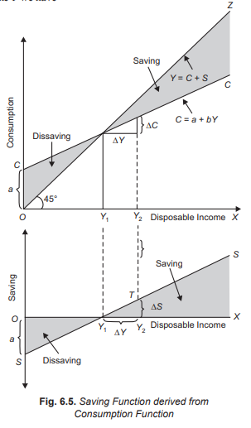
Continue…

Slide 7
Continue
Marginal Propensity to Save (MPS).
The marginal propensity to save is therefore change in saving induced by a change in the disposable income.
MPS = ∆ S /∆Y
the sum of marginal propensity to consume and marginal propensity to save is equal to one.
MPC + MPS = 1
This can be mathematically proved as under:
From C + S = Y,
it follows that any change in income (∆Y) must induce either change in consumption (∆C) or change in saving (∆S).
Thus. ∆C + ∆S = ∆Y
Dividing both sides by ∆Y we have
∆ C/ ∆ Y + ∆ S/ ∆ Y= ∆ Y/ ∆ Y = 1
MPC + MPS = 1

Slide 8
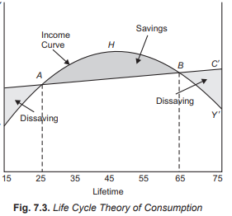
LIFE CYCLE THEORY OF CONSUMPTION
An important post-Keynesian theory of consumption has been put forward by Modigliani and Ando which is known as life cycle theory. According to life cycle theory, the consumption in any period is not the function of current income of that period but of the whole lifetime expected income.

Slide 9
Break
10 Minutes

Slide 10
Investment “I”
Investment mean the addition to the stock of physical capital.
Thus, in economics, investment means the new expenditure incurred on addition to the stock of capital goods such as machines, buildings, equipment, tools, etc.
TYPES OF INVESTMENT
Business fixed investment
Residential investment
Inventory investment

Slide 11
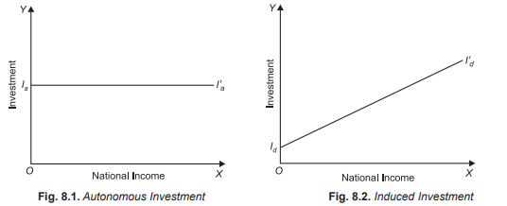
Autonomous Investment and Induced Investment
Autonomous investment refers to the investment which does not depend upon changes in the income level. This autonomous investment generally takes place in houses, roads, public undertakings and in other types of economic infrastructure such as power, transport and communication. This autonomous investment depends more on population growth and technical progress than on the level of income
Induced investment is shown, with the increase in national income, induced investment is increasing. Increase in national income implies that demand for output of goods and services increases.

Slide 12
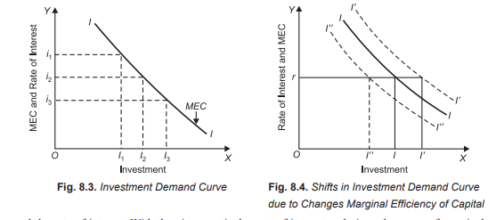
KEYNES’S THEORY OF INVESTMENT
According to Keynes investment demand depends upon two factors: (1) expected rate of profits to which Keynes gives the name Marginal Efficiency of Capital, (MEC) and.
(2) the rate of interest.
Rate of Interest and Investment Demand Curve

Slide 13
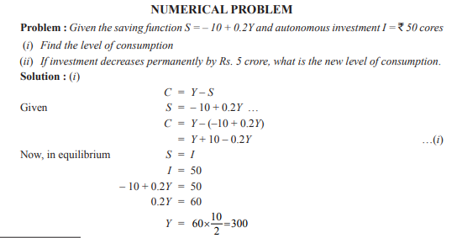
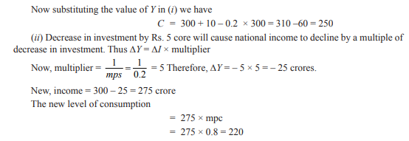

Slide 14
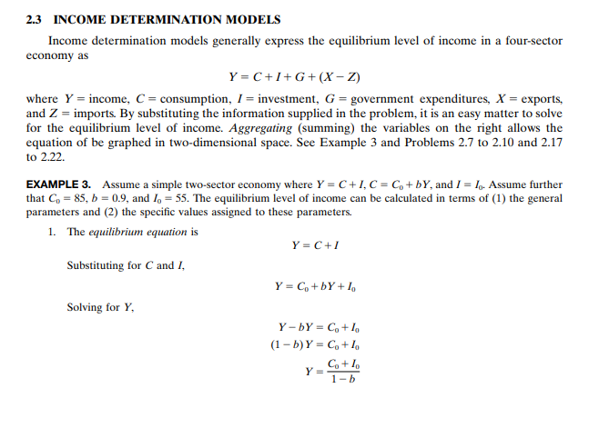

Slide 15
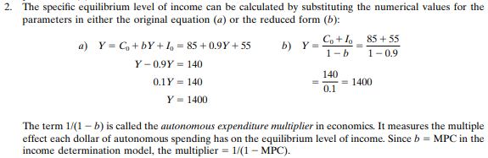

Slide 16
